Slide 1







Forecasting Indonesia Renewable Energy
Contribution to Electricity Generation Using ARIMA Method
WAHYU IKBAL MAULANA

Slide 2


BACKGROUND
In an effort to address the impacts of climate change and achieve greenhouse gas emission reduction targets, Indonesia faces the challenge of meeting its growing energy needs while reducing dependence on fossil fuels. Renewable energies such as solar, wind, water, geothermal, and biomass offer a more environmentally friendly and sustainable solution.
This research proposes the use of Autoregressive Integrated Moving Average (ARIMA) method to forecast the contribution of renewable energy in electricity generation in Indonesia.

Slide 3



GOALS
Using ARIMA method to predict the contribution of renewable energy in electricity generation in Indonesia.

Slide 4
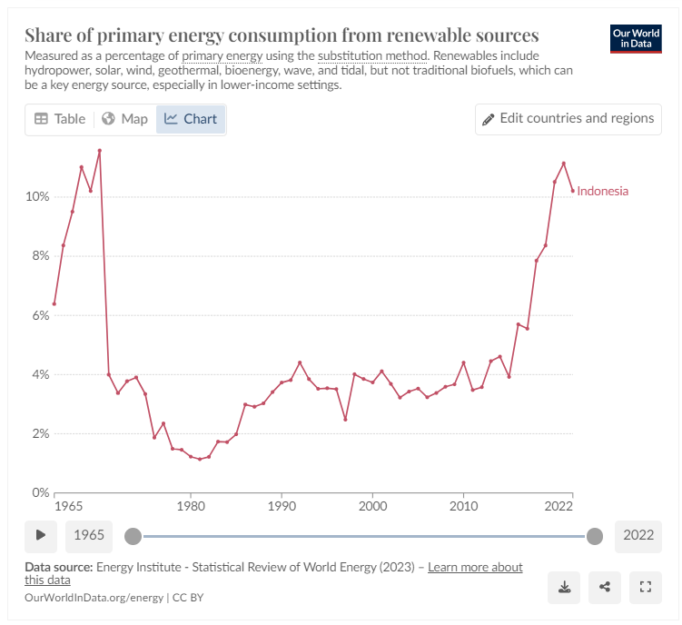
DATA SOURCE
Renewable energy here is the sum of hydropower, wind, solar, geothermal, modern biomass and wave and tidal energy.
Traditional biomass – the burning of charcoal, crop waste, and other organic matter – is not included. This can be an important energy source in lower-income settings.
Energy Institute - Statistical Review of World Energy (2023) – with major processing by Our World in Data

Slide 5
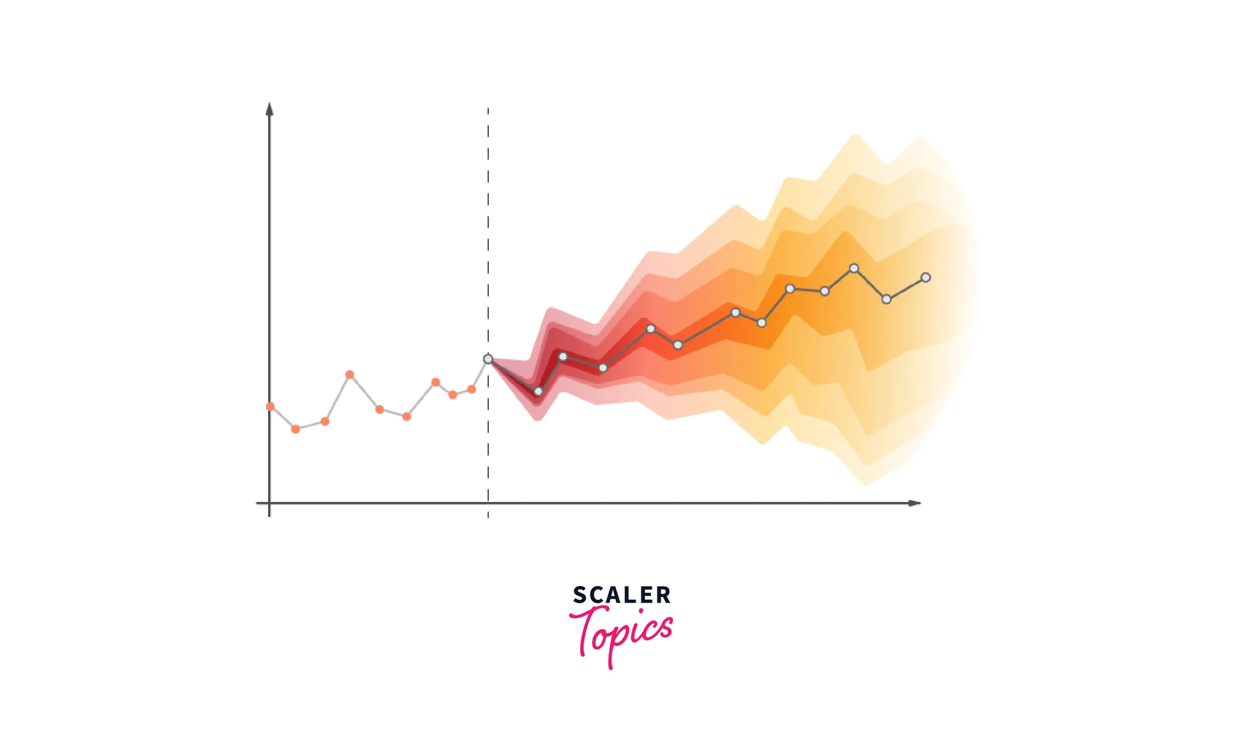
METHODOLOGY
In this research, the focus lies on predicting Indonesia's renewable energy contribution, leveraging the renewable energy contribution data spanning from 1965 to 2022. The predictive process will harness Python packages such as statsmodels.tsa.stattools and statsmodels.tsa.arima.model. The ARIMA forecasting method entails the following steps: (1) Identification, (2) Estimation (and selection), (3) Diagnostic checking, and (4) Model implementation.

Slide 6
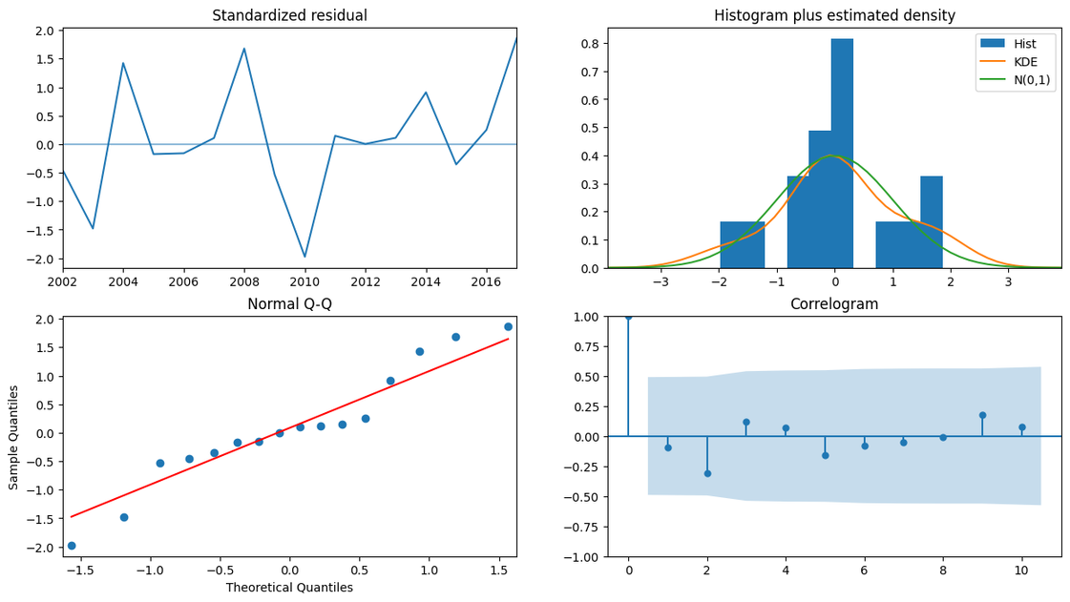
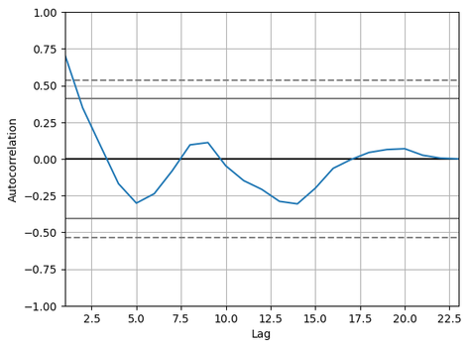
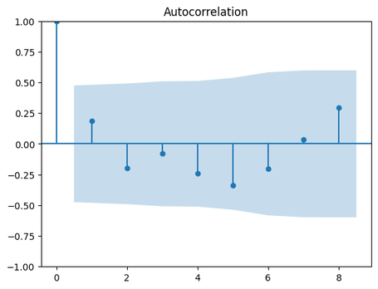
RESULT
and discussion

Slide 7
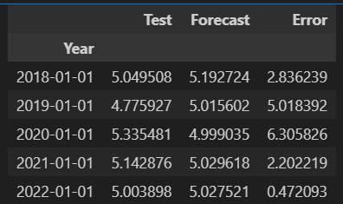
The three best modelorders based on RMSE
No | Model | RMSE
1 | ARIMA (0,0,1) | 0.2117
2 | ARIMA (3,1,1) | 0.2022
3 | ARIMA (3,2,2) | 0.2091
Comparison of the prediction results for the next 5 years with the actual data

Slide 8
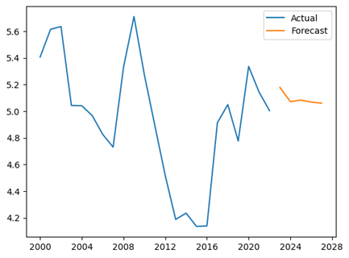
RESULT
AND CONDITION
5 Years forecasting using ARIMA (3,1,1)

Slide 9

CONCLUSION
Based on the results of data analysis and discussion, this research concludes that the ARIMA(3,1,1) method was suitable for forecasting the data of renewable energy (total primary energy supply) in Indonesia. This conclusion is supported by the RMSE value of ARIMA(3,1,1), which is 0.2022, indicating a good fit for the data. The lower RMSE value demonstrates that the ARIMA(3,1,1) method can effectively capture the patterns and trends in the historical data, providing reliable forecasts that can aid in strategic planning and decision-making for the sustainable energy transition in Indonesia.

Slide 10
THANK YOU

